Slide 1


Impacts of Stay-at-Home Order
Group 2 Stay-at-home Flyer
05/18/2020

Slide 2
Research Problems
Economy:
What types of stocks are more robust, and what stocks are more vulnerable during the pandemic?
Since the unemployment rate should rise, which industries have the highest increase in the unemployment rate? And which may be slightly impacted?
Life:
Tweet:
Do people pay attention to the “Stay-at-Home” policy on Twitter before and after its promulgation?
What are the popular discussion topics about Covid-19?
Mobility:
What’s the start date and end date of the policy for each state?
What impact will the “Stay-at-Home” policy have on mobility?

Slide 3
Method
Data cleaning and preprocessing
Tool: Spark, Python(Pandas, NumPy), Jupyter notebook
Methods:
Drop duplicates
Null value
Integrate tables (join)
Select valuable data
Clustering: ngrams, fingerprint, metaphone3, KNN, regex …
Visualization
Tool: Plotly

Slide 4
Economy

Slide 5
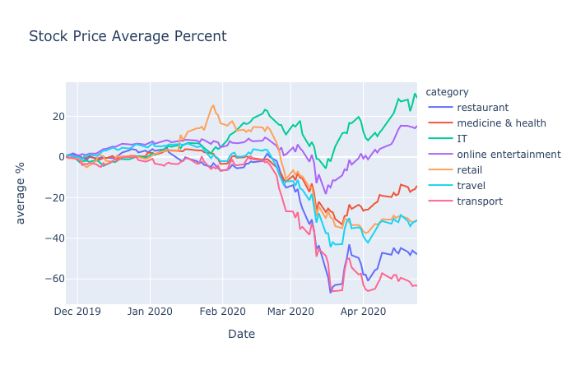
Stock – Overview

Slide 6
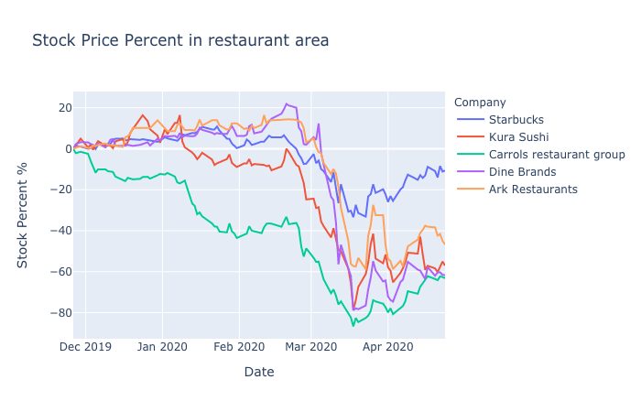
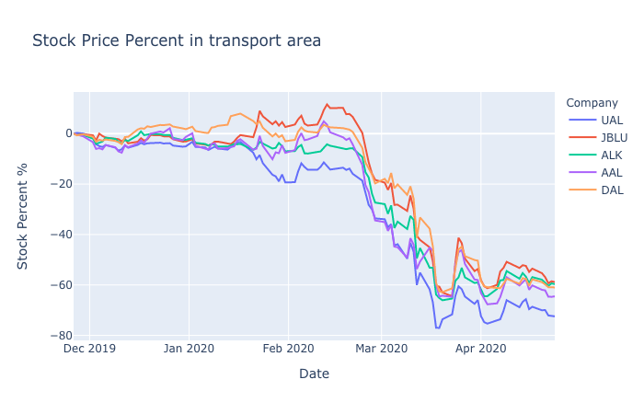
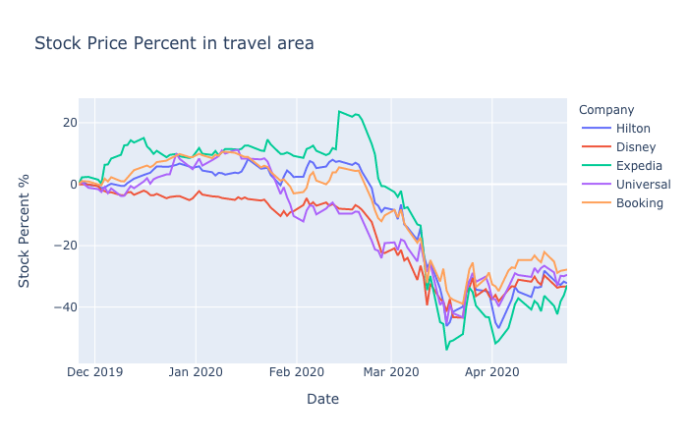
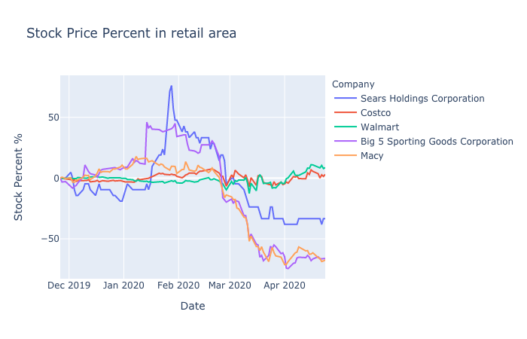
Stock – Vulnerable industries

Slide 7
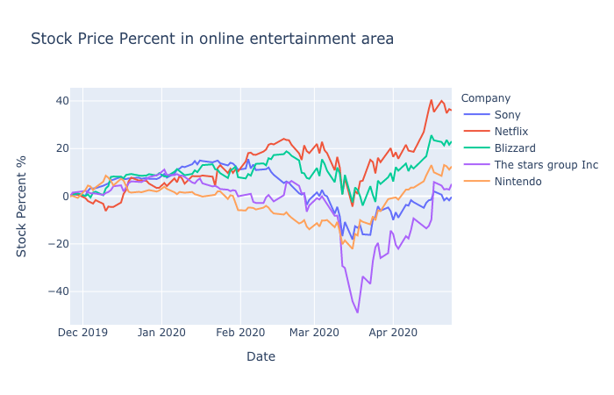
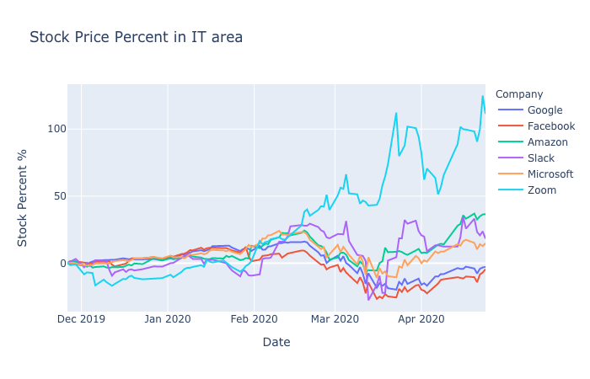
Stock – Robust industries

Slide 8
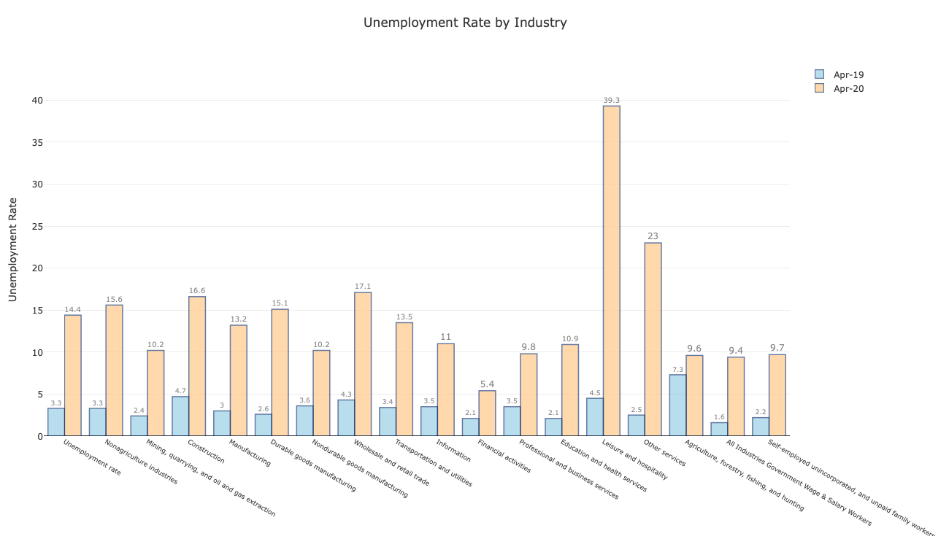
Unemployment Rate

Slide 9
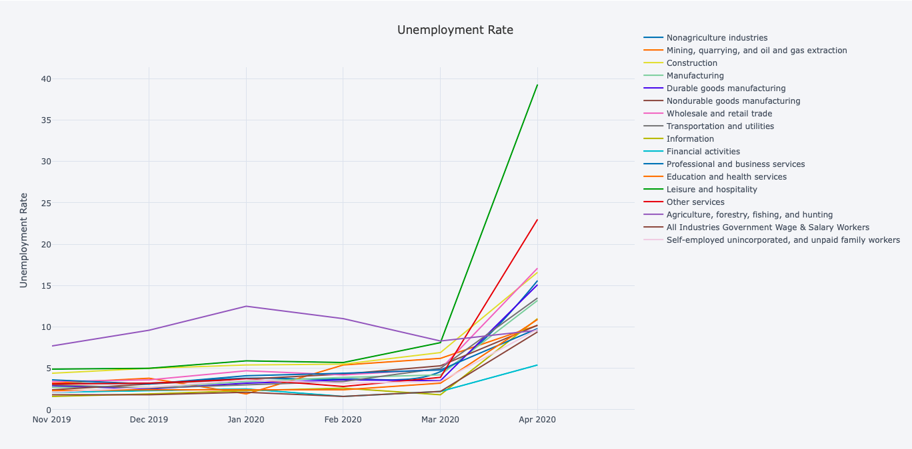
Unemployment Rate

Slide 10
Life

Slide 11
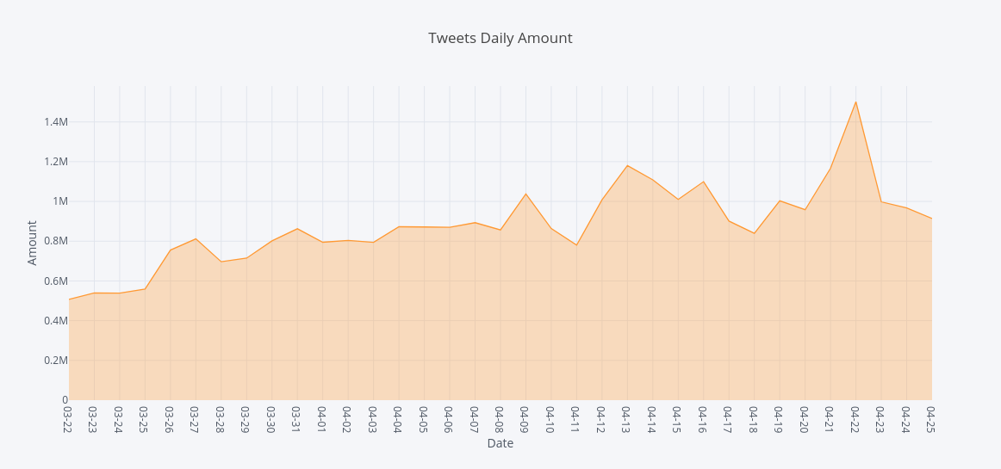
Tweet – Daily tweet amount
April 9: confirmed cases April 13: Delivery
April 22: social activities

Slide 12
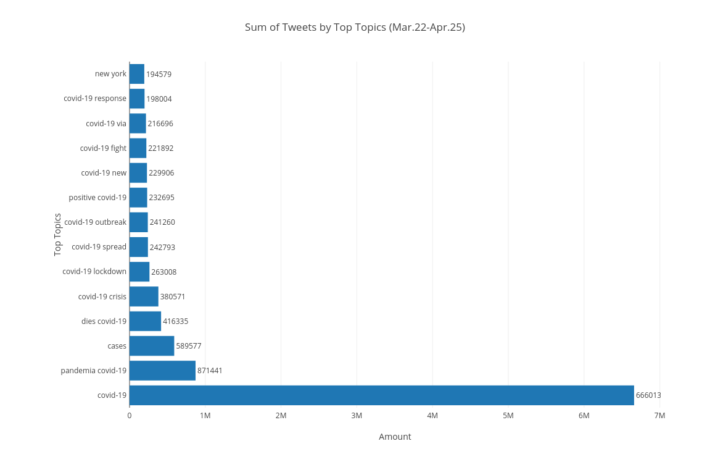
Tweet – Sum of Tweets by Topics

Slide 13
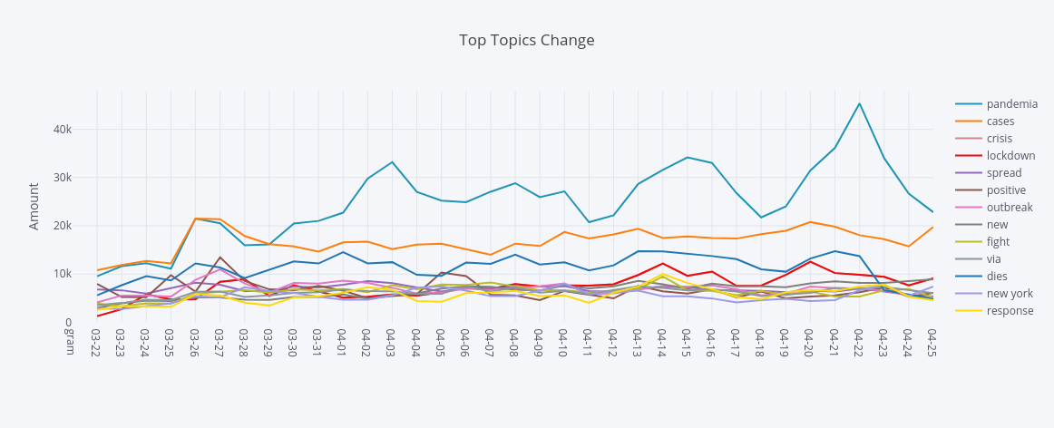
Tweet – Top Topics Change
4.12: increase -- policy issued
4.20: peak -- resumption of work

Slide 14

Tweet – Daily Top 20 topics

Slide 15
Mobility
“Stay-at-Home” Announcement
Country Level
State Level
County Level

Slide 16
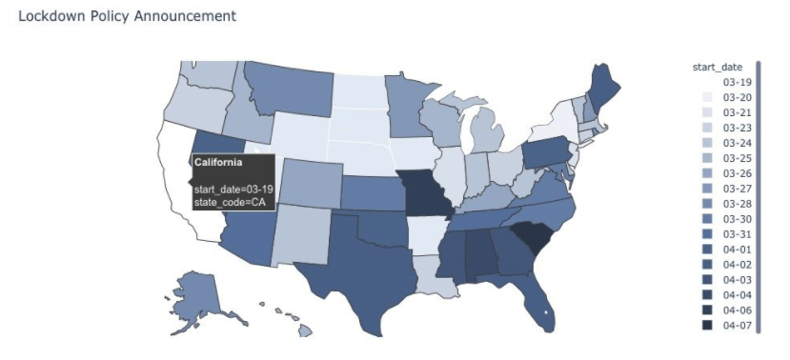
“Stay-at-Home” Order Announcement
Seven states didn’t announce
California - first - 03/19
South Carolina - last - 04/07
Median Announcement Date: 03/28
Coast states median date: 03/24
Inland states median date: 04/02

Slide 17
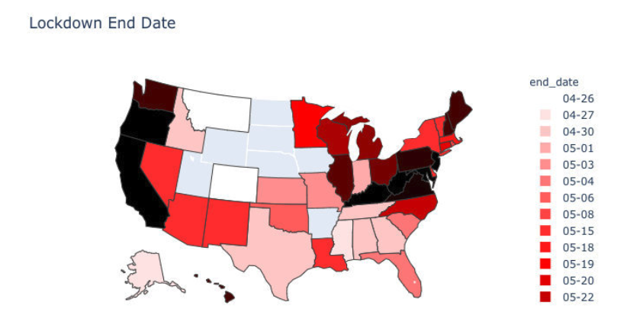
“Stay-at-Home” Order Announcement
Fetch data on April 26, may change later
Southern America - end of April
Northern America - end of May
Those who announced the order earlier are more likely to stay at home
Shortest 25 days, longest more than 60 days

Slide 18
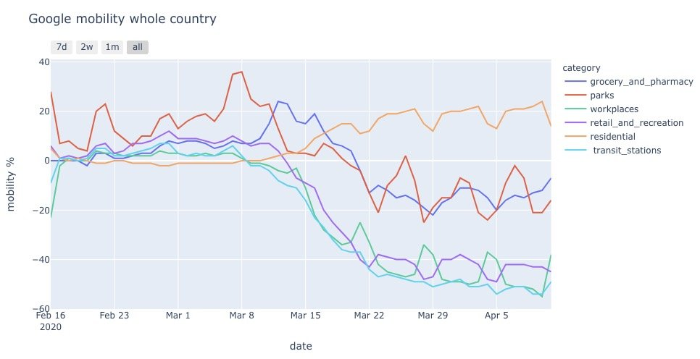
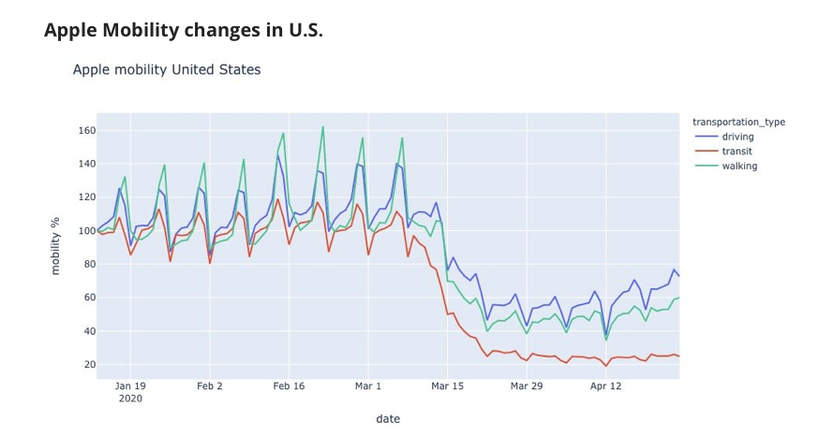
Country Level

Slide 19
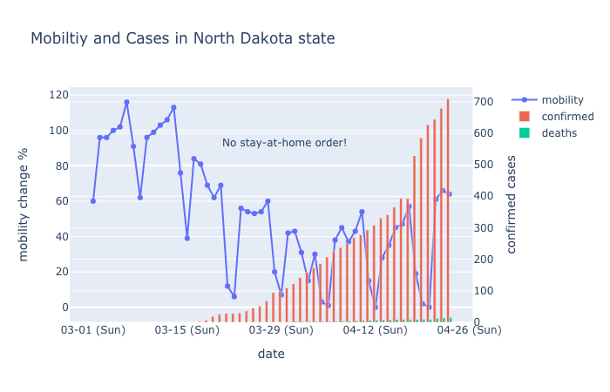
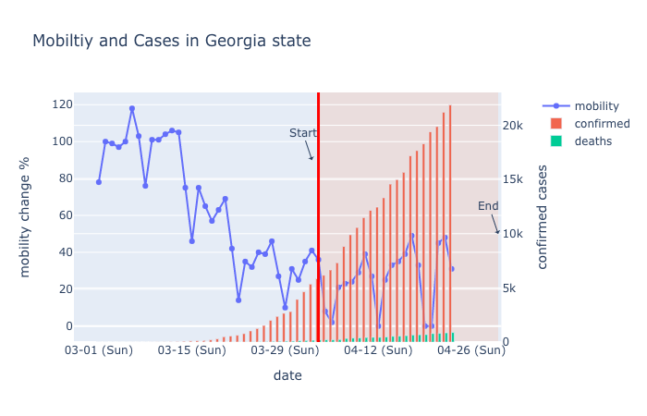

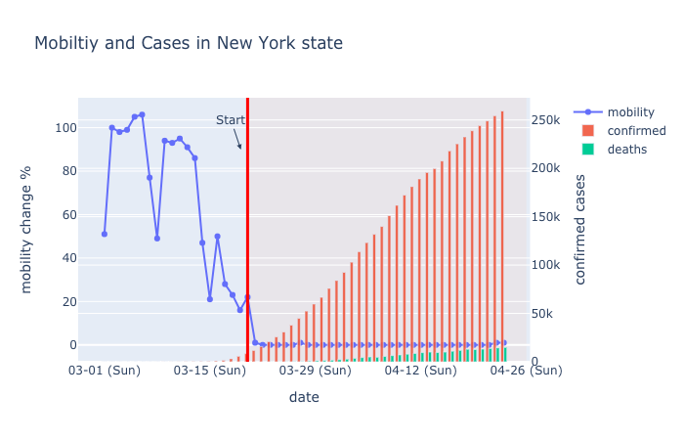
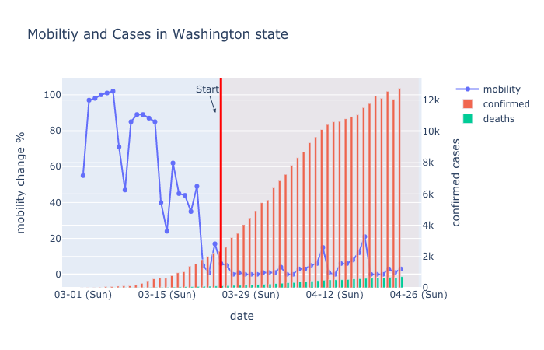
State Level – cases & mobility
New York
Texas
Georgia
North Dakota
Washington

Slide 20
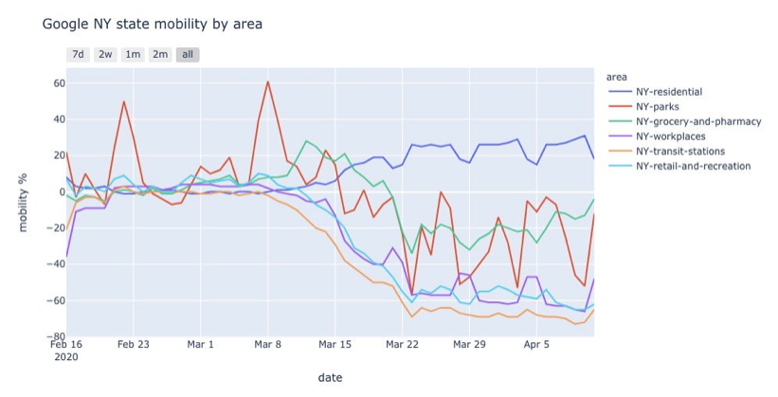
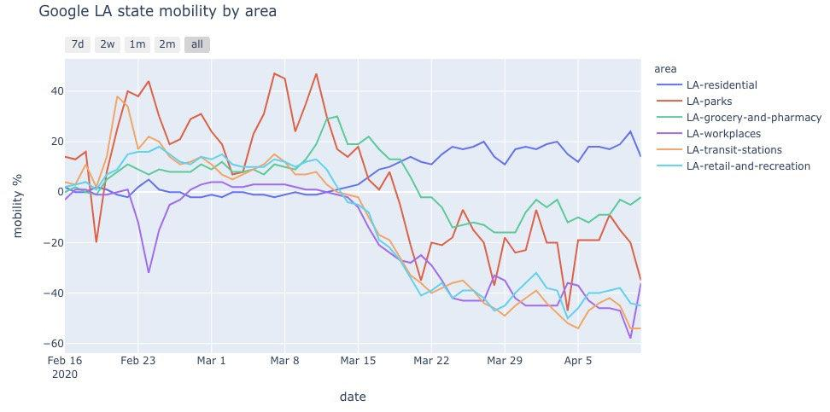
State Level – mobility by area
Parks area - peaks at weekends
Transit station area in NY - remain low

Slide 21
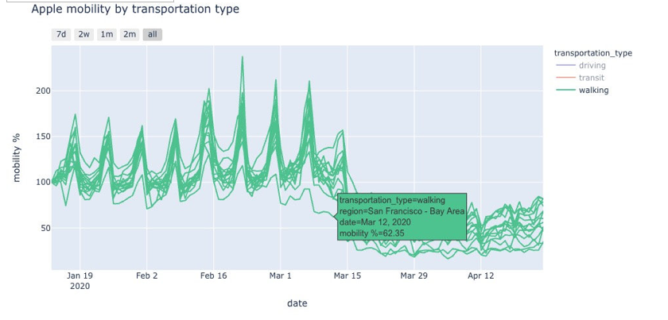
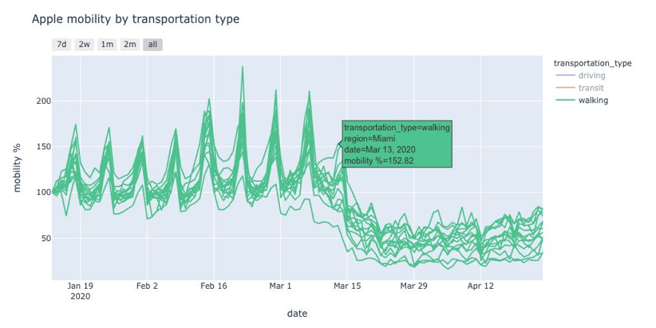
State Level – mobility outliers

Slide 22
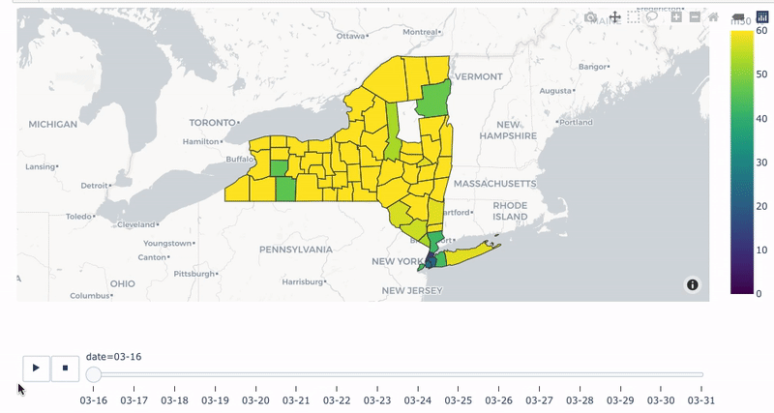
County Level – Mobility Drop
Order date: 03/20

Slide 23
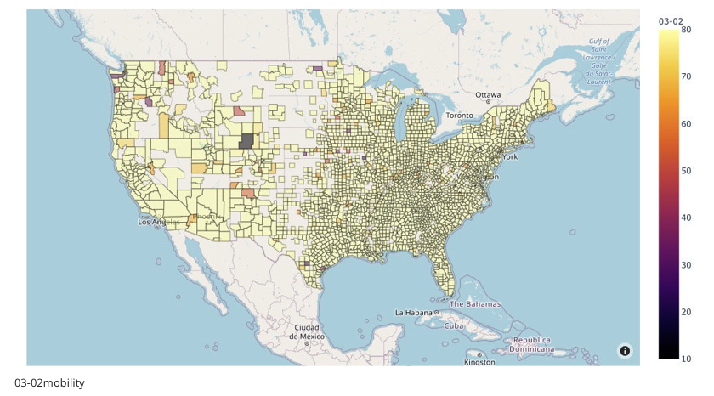
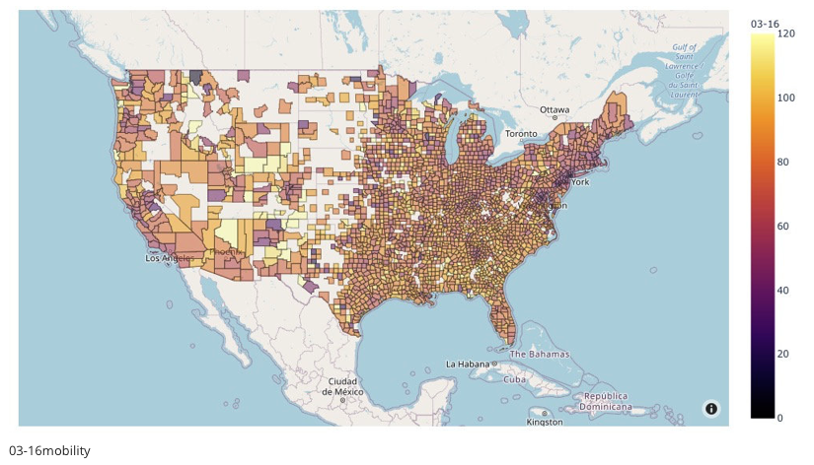
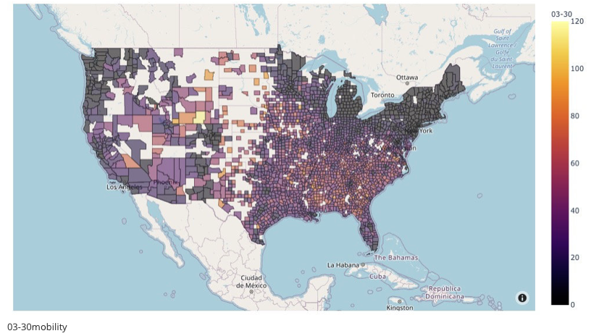
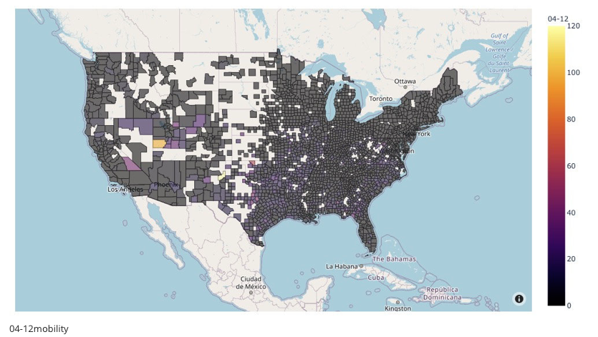
County Level – Mobility map

Slide 24
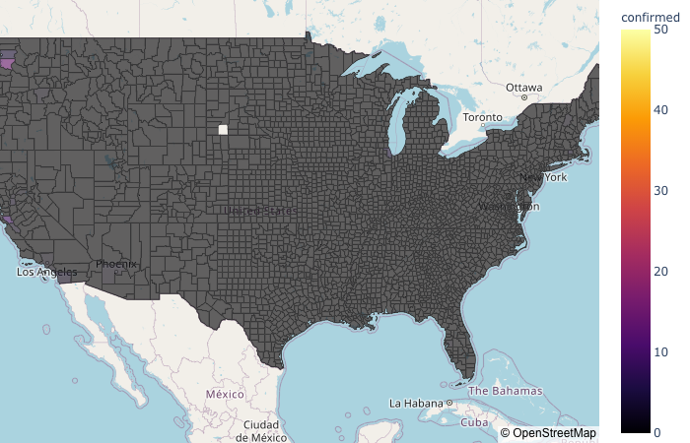

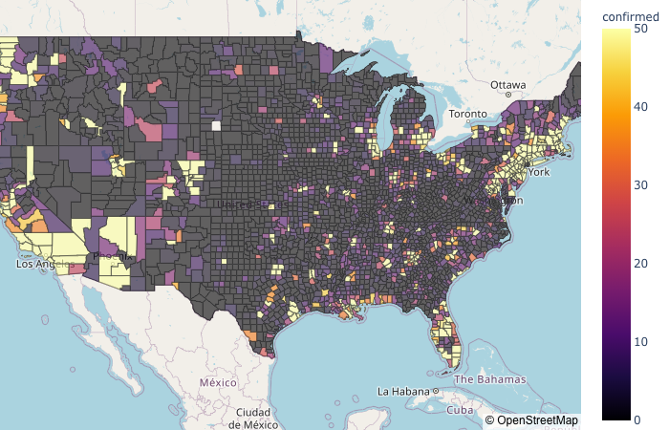
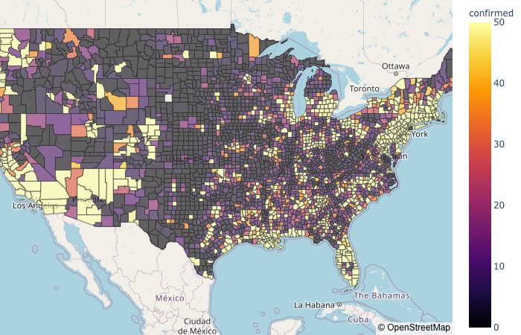
County Level – Case map

Slide 25
Thank you!

